Slide 1
CHAPTER
20
Income Inequality
and Poverty
Notes:
This is the third of three chapters on the economics of labor markets. In Chapter 18, students learned that equilibrium wages equal the value of the marginal product of labor. In Chapter 19, students learned about various factors that affect equilibrium wages, as well as discrimination.
In Chapter 20, students will learn about the extent of inequality and poverty in the U.S. The chapter also introduces some of the leading political philosophies on the role of government in redistributing income. Finally, the chapter discusses some policies designed to help the poor.
This chapter is shorter than average. Most students find it less difficult than average. Therefore, most instructors are able to cover it in about 60 minutes of class time.

Slide 2
Look for the answers to these questions:
How much inequality and poverty exist in our society?
What are the problems measuring inequality?
What are some of the leading philosophies on the proper role of government in altering the distribution of income?
What policies are used to fight poverty? What are the problems with these policies?

Slide 3
Introduction
In the absence of discrimination
The income distribution in a market economy may not be equitable or otherwise desirable.
In this chapter, we examine:
Indicators of inequality and poverty
Philosophies about income redistribution
Policies designed to help the poor
Notes:
From the previous two chapters: Equilibrium wages equal the value of workers’ marginal products
Differences in equilibrium wages result from differences in
- Worker characteristics: education, experience, talent, effort
- Job characteristics: extent to which a job is pleasant and safe
- Discrimination.

Slide 4
The U.S. Income Distribution: 2014
Group | Annual household income
Bottom quintile | Under $21,430
Second quintile | $21,430– $41,166
Middle quintile | $41,167 – $68,199
Fourth quintile | $68,200 – $112,253
Top quintile | $112,254 and over
Top 5 percent | $206,563 and over
Notes:
This is an updated version of Table 1 in Chapter 20. Source: U.S. Bureau of the Census, Historical Income Inequality Tables, available at:
https://www.census.gov/data/tables/time-series/demo/income-poverty/cps-hinc/hinc-05.html
There’s one key difference: This table refers to households rather than families.

Slide 5
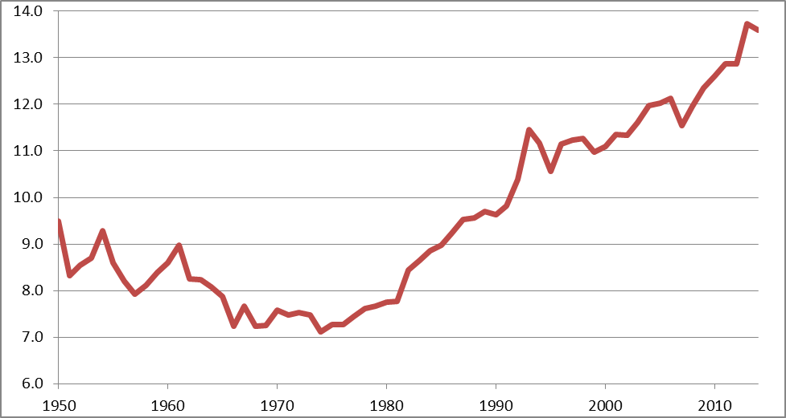
U.S. Income Inequality, 1950–2014
Income share of the top 20% divided by income share of the bottom 20%
Notes:
Each point is the ratio of two numbers:
The share of U.S. income received by the top 20% of families, relative to the share of U.S. income received by the bottom 20%.
Source: U.S. Census Historical Income ,
https://www.census.gov/data/tables/time-series/demo/income-poverty/historical-income-families.html

Slide 6
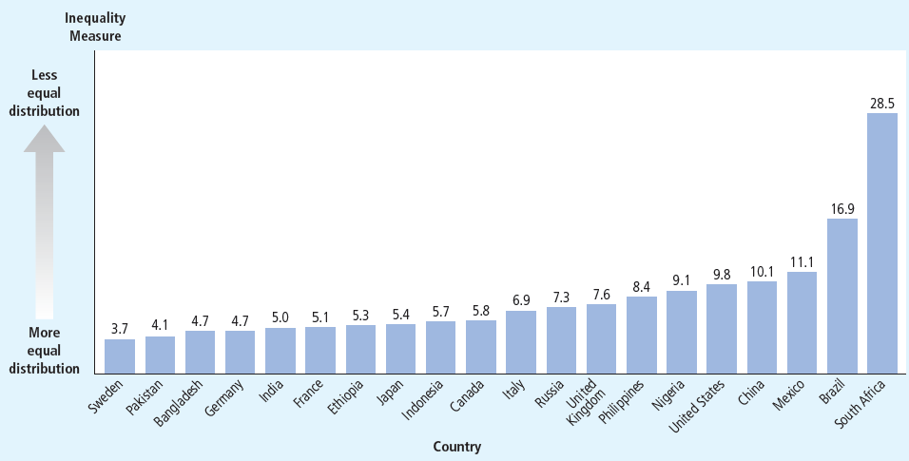
Inequality around the World
Income share of the top 20% divided by income share of the bottom 20%
Notes:
Source: Figure 1, Chapter 20.
Original source: Human Development Report 2011.
This figure shows the ratio of the income of the richest quintile to the income of the poorest quintile. Among these nations, Sweden and Pakistan have the most equal distribution of economic well-being, while South Africa and Brazil have the least equal.

Slide 7
Poverty
Poverty rate
Percentage of the population whose family income falls below an absolute level (poverty line)
Poverty line
Set by the federal government (three times cost of providing an adequate diet)
Depends on family size
Adjusted every year to account for changes in the level of prices

Slide 8
Poverty
0
In 2014 in the U.S.,
Median family income = $66,632
Poverty line for family of four = $24,418
Poverty rate = 14.8%
Notes:
8
The figures on this slide are updated from the textbook.
Source for poverty figures:
https://www.census.gov/data/tables/2015/demo/income-poverty/p60-252.html
Source for median family income:
https://www.census.gov/data/tables/time-series/demo/income-poverty/cps-finc/finc-01.html

Slide 9
U.S. Poverty Over Time
Percent of the population below poverty line
Notes:
The poverty rate appears correlated with business cycles. For example, 1992–2000 was the longest economic expansion on record, and it coincided with a gradual fall in the poverty rate. The U.S. experienced recessions in the early 2000s and 2008–2009, and the poverty rate rose in each.
In the first part of the 1960s, the fall in poverty is likely due to macroeconomic recovery. The “War on Poverty” in the 1960s led to a significant expansion of the government’s social safety net beginning in the mid-1960s, which coincided with further reductions in poverty. Safety net programs will be discussed toward the end of this chapter.
Source of data: U.S. Bureau of the Census.
https://www.census.gov/data/tables/time-series/demo/income-poverty/historical-poverty-people.html Table 2

Slide 10
U.S. Poverty Rate by Group, 2012
0
Group | Poverty Rate
All persons | 14.8%
White, not Hispanic | 10.1
Black | 26.2
Hispanic | 23.6
Asian | 12.0
Children | 21.1
Elderly | 10.0
Married-couple families | 6.2
Female household, no spouse present | 33.1
Notes:
10
This slide updates the data in Table 3 of Chapter 20.
Source: U.S. Bureau of the Census, https://www.census.gov/data/tables/time-series/demo/income-poverty/historical-poverty-people.html
Tables 3 and 4.
Additionally, as of 2014, the poverty rate among Veterans of the U.S. Armed Forces was 6.7% for males and 9.4% for females. Source: U.S. Department of Veterans Affairs
http://www.va.gov/vetdata/docs/SpecialReports/Profile_of_Veterans_2014.pdf

Slide 11
Problems in Measuring Inequality
Data on income distribution & poverty rate
Incomplete picture of inequality
Household annual income
Doesn’t account for in-kind transfers
Transfers to the poor in the form of goods and services rather than cash

Slide 12
Problems in Measuring Inequality
Data on income distribution & poverty rate
Normal life cycle pattern
Causes inequality in the distribution of annual income
May not represent true inequality in living standards
Life cycle: regular pattern of income variation over a person’s life
People can borrow and save to offset life-cycle changes in income (e.g., saving for retirement).

Slide 13
Problems in Measuring Inequality
Data on income distribution & poverty rate
Transitory vs. permanent income
Transitory changes - need not affect standard of living
A family’s ability to buy goods and services depends largely on its permanent income
Permanent income: a person’s normal income

Slide 14
Economic Mobility
Economic mobility
Many people move among income classes
Some reflects transitory variation in income
Some reflects more persistent changes in income
Many of those below the poverty line are there only temporarily
Notes:
The poverty and inequality measures discussed above do not distinguish between the temporarily poor and the persistently poor.
Persistence of economic success from generation to generation: Above-average income carries over from parents to children
Four of five millionaires made their money on their own; One in five millionaires inherited their fortunes

Slide 15
Political Philosophy
What should the government do about economic inequality?
Political philosophies of redistributing income
Utilitarianism
Liberalism
Libertarianism

Slide 16
Utilitarianism
Utility:
A measure of happiness or satisfaction
Utilitarianism:
Government should choose policies to maximize society’s total utility
Founders: Jeremy Bentham, John Stuart Mill

Slide 17
Utilitarianism
Because of diminishing marginal utility
Redistributing income from rich to poor increases utility of the poor more than it reduces utility of the rich.
Yet, utilitarians do not advocate equalizing incomes
Would reduce total income of everyone due to incentive effects and efficiency losses.

Slide 18
Liberalism
Liberalism:
Government should choose policies deemed to be just by an impartial observer behind a “veil of ignorance.”
Founder: John Rawls
Maximin criterion:
Government should aim to maximize the well-being of society’s worst-off person

Slide 19
Liberalism
Liberalism:
Calls for more redistribution than utilitarianism (though still not complete equalization of incomes).
Income redistribution is a form of social insurance, a government policy aimed at protecting people against the risk of adverse events.

Slide 20
Libertarianism
Libertarianism:
Government should punish crimes and enforce voluntary agreements but not redistribute income
Advocate: Robert Nozick
Libertarians focus on the process not outcome:
Government should enforce individual rights, should try to equalize opportunities.
If the income distribution is achieved fairly, government should not interfere, even if unequal
Notes:
At this point, you might pause the lecture for a short class discussion on the relative merits of these alternative philosophies. If you have the sense that your students are tolerant of opposing viewpoints, you might ask for students to pick the philosophy with which they most identify. If you sense that students would feel more comfortable answering the question anonymously, consider posing it to them using a classroom response system (“clickers”) or the internet-based equivalent, PollEverywhere.com.

Slide 21
Policies to Reduce Poverty
Poor families more likely to experience
Homelessness, drug dependence, health problems, teen pregnancy, illiteracy, unemployment
Most people believe government should provide a “safety net.”
We now consider a few such policies…

Slide 22
1. Minimum-Wage Laws
Arguments for:
Helps the poor without any cost to government
Little impact on employment if demand for unskilled labor is relatively inelastic.
Arguments against:
In the long run, demand for unskilled labor is likely elastic, so minimum wage causes substantial unemployment among the unskilled.
Those helped by minimum wage are more likely to be teens from middle-income families than low-income adult workers.
Notes:
Students will recall the effects of the minimum wage from Chapter 6, which covered price floors and ceilings.
A few additional notes about the minimum wage:
Yes, it helps the poor at no cost to the government. But there’s no such thing as a free lunch. The minimum wage transfers income to workers from firms (or rather, their owners) and from consumers, who will end up paying higher prices for goods made with unskilled labor.
Some people think of the minimum wage as a law that prohibits people from working if they aren’t able to find a job that pays at least $7.25 an hour.

Slide 23
2. Welfare
Welfare: government programs that supplement the incomes of the needy
Temporary Assistance for Needy Families (TANF)
Supplemental Security Income (SSI)
Critics: such programs create incentives to become or remain needy; welfare contributed to the rise of the single-parent family.
However, the severity of such incentive problems is unknown.
Proponents: inflation-adjusted welfare benefits fell as single-parent families increased.

Slide 24
3. Negative Income Tax
Negative income tax:
Tax system that collects revenue from high-income households and gives transfers to low-income households
The Earned Income Tax Credit (EITC)
Is similar to a negative income tax.
Notes:
Example: Taxes owed=(1/3 of income) – $10,000
If earnings = $90,000, taxes owed = $20,000
If earnings = $60,000, taxes owed = $10,000
If earnings = $30,000, taxes owed = $0
If earnings = $15,000, taxes “owed” = –$5,000 (would receive $5,000 payment from government)
With a negative income tax, the marginal tax rate is as low for low income persons as it is for high income persons. This is in sharp contrast to other welfare-type programs, which take away benefits as income rises, thus creating very high effective marginal tax rates for the poor.
I encourage you to check out Mankiw’s January 2014 column in the New York Times contrasting the EITC and minimum wage. It’s clear, well-argued, and short. Find it here:
http://www.nytimes.com/2014/01/05/business/help-the-working-poor-but-share-the-burden.html

Slide 25
4. In-Kind Transfers
In-kind transfers: goods or services provided to the needy
Examples: homeless shelters, soup kitchens
Supplemental Nutrition Assistance Program (SNAP): Gives low-income families a plastic card that can be used to buy food at stores
Medicaid, government-provided healthcare for the poor
An alternative: cash payments
People - buy what they most need; but critics argue could be used for drugs, alcohol
Notes:
A cash payment would let workers buy whatever they think they most need. Many economists believe that the government cannot know what people need better than the people themselves.
Regarding the argument that the recipients could spend the money on drugs:
Suppose the choice is giving the person $50 cash or $50 worth of food. If you give them $50 cash, they could buy drugs. If you give them $50 worth of food, they spend $50 less of their own money on food, and can now spend this $50 on drugs. The outcome is the same in either case.

Slide 26
Anti-Poverty Programs and Work Incentives
Assistance from anti-poverty programs declines as income rises.
The result: Poor families face high effective marginal tax rates (exceeding 100% in some cases!).
Such policies therefore discourage the poor from escaping poverty on their own.
One possible solution: “Workfare,”
System requiring people to accept government jobs while collecting benefits.
Notes:
As noted two slides above, the negative income tax is an exception to the second bullet point: poor families do not face high marginal tax rates under the negative income tax, so it does create a work disincentive.

Slide 27
Conclusion
Poverty is one of society’s most serious problems.
Governments can sometimes improve market outcomes.
Public policy can help reduce poverty and inequality
People face trade-offs.
Policies designed to improve equity often sacrifice efficiency, so the proper scope of policy is the subject of ongoing controversy

Slide 28
Summary
Data on income distribution show a wide disparity in our society. The richest 20% of families earn about ten times as much as the poorest 20%.
Problems in measuring inequality arise from in-kind transfers, the economic life cycle, transitory income, and economic mobility.
When these factors are taken into account, the distribution of well-being is probably less unequal than the distribution of annual income.

Slide 29
Summary
Political philosophers differ in their views of the proper role of government in altering the income distribution.
Utilitarians believe that income distribution should maximize the sum of everyone’s utility.
Liberals believe the government should aim to maximize the well-being of the worst-off person in society.
Libertarians believe the government should aim for equality of opportunity, not equality of income.

Slide 30
Summary
Policies such as welfare, minimum-wage laws, negative income taxes, and in-kind transfers can help the poor.
Since financial assistance falls as income rises, the poor face high effective marginal tax rates, discouraging them from escaping poverty on their own.

